Slide 1
Advanced Mobile Games CSCI 526 myth smash
Game Flow Document

Slide 2
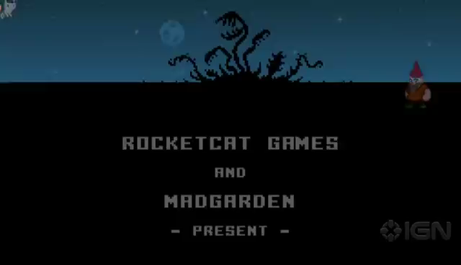
Game Overview
The game will be built on Unity3d 4.3 version.
2-D platformer game.
Inspired from game: punch quest.

Slide 3
Game Features
Endless runner with Fast Pace movement
Hack & Slash style for combat with QuickTime events
2D Physics with Rigid bodies and Ragdolls.
Level and environment explosion/destruction.
Combat System with power ups, skins, vehicles, and different characters
AI Enemies ( Melee, Range, Flying)
AI Final Bosses
Procedural Level Generation with Level Traps
Particles and Visual Effects
Inventory with support for Power ups/ Upgrades, skins and characters
Basic UI ( Main Menu, Pause, About, Settings, Intro,..Etc.)
Device Compatibility with iOS, Android, and VITA( if we have a Unity3D license)
Audio System ( Music and Sounds )
Social Integration( GREE, Facebook and twitter ).

Slide 4
Game Flow
The game will comprise of 4 main screens:
Splash screen
Start screen
Game screen
Score screen
There will be some optional screens like pause screen, menu screen etc.
The basic flow of the game will be
Splash Screen
Start Screen
Game Screen
Score Screen
Intermediate/Optional Screens

Slide 5
Splash screen
Game Poster
This screen is starting screen of the game.
Contains a wallpaper/background/poster.
Fade away in 3 seconds.
Provide time for game loading.
Contains game name.
Company’s name or studio name may be present on
This screen.
GAME LOADING… Message

Slide 6
START SCREEN
Life
Power Up
Score
This is a screen just before the game starts.
Contains various menu options.
For this game: tapping the screen will launch the game.
This screen will contain a small animation playing
in the background while the user makes up the mind.
Animation
Tap to Start
Settings
Shop
Share

Slide 7
Game Screen
This screen consists of the main game components.
It consists of background, Levels, enemies etc.
Pause
Life
Powerups
Score
Game Area
Left Thumb Area/ Jump Control
Right Thumb Area/ Punch Control

Slide 8
Class Flow
Main Class/
Game Controller
AI Subsystem
Physics Subsytem
Level Loading
Hero Subsystem
Menu Controller
Social Media Handler
Sound Manager
Input Handler

Slide 9
Game design
Game has a main class that controls the flow of game.
Main class is responsible to co-ordinate between different subsystems and maintaining the flow of game.
Splash screen will be responsible for the trigger of start screen.
Events will be managed by Event manager class; A sub class of main class.
Event manager maps the areas sensing touch to the functions to be performed.
A jump event initiates jump animation, updating position of hero(Physics subsystem), ai subsystem etc.
A punch event initiates punch animation, physics subsystem perform collision detection with enemies.
Sound Subsystem works parallel to all other subsystem so as to be available all the time.

Slide 10
Subsystems
Game Flow
Physics
Hero and combat system
Animation
ai/enEmies
Level generation
Particles/effect
Inventory/store
Ui
Input controls
Music/sound
Social features

Slide 11
Menus
Settings
About menu
Character customizing menu
Sound (on/off)
Credits
Inventory/ shop
Buy Power ups
Buy new skins
Buy new characters
Buy weapons
Social media sharing
Sharing on facebook, twitter, pinterest etc.

Slide 12
About menu
Tells about the game.
Tells about the controls.
Tells about various characters and weapon.
Some tricks and tips.

Slide 13
Character customizing
Customize head gear.
Customize skin color.
Customize clothes.
Select from various schemes like: Power 90%, damage: 30% etc.
Select weapons.
-- everything comes with a price. The price for custom items will be the coins/points you earn.

Slide 14
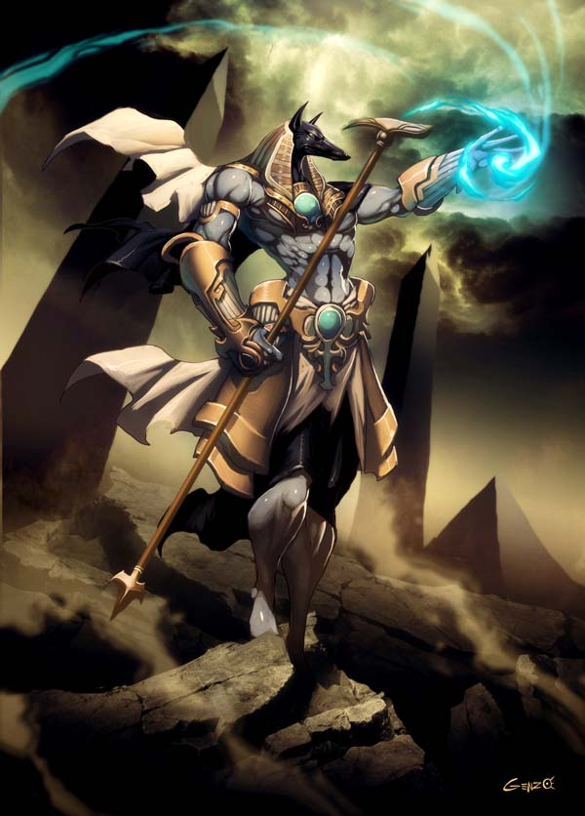
HERO AND COMBAT SYSTEM
The hero CAN PERFORM 3 MAIN ACTIONS:
ATTACK
JUMP
BLOCK
PLAYABLE CHARACTERS WILL BE MYTHOLOGICAL CHARACTERS FROM DIFFERENT CULTURES (INDIAN, EGYPTIAN, GREEK AND POSSIBLY OTHERS)
ABILITY TO CONTROL VEHICLES (Chariots) and ride or turn into animals (possibly sphinxes, legendary indian creatures such as the garuda, and more)

Slide 15
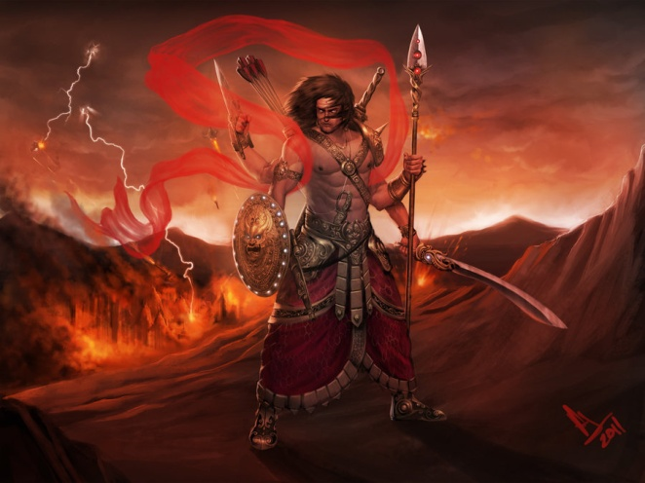
HERO AND COMBAT SYSTEM
The hero’s weapon system will include:
Main melee attack
Ability to throw projectiles
Special powers based on their mythological background
The hero’s abilities and equipment will follow a diablo-style loot system.
Players will be rewarded for opening hidden chests and defeating bosses
rewards include new head or chest armor, new melee and projectile weapons, new special powers, and skill points to upgrade their abilities
Players can choose which hero to play with. Each hero will begin with a specific gear and set of traits.
These traits may include attack strength, speed, vitality, and more.

Slide 16
Enemy and AI Subsystem
Enemy instance creation according to the level of progress of the player in the game.
Handling different types of enemies.
Handling different types of attacks.
Physics including Ragdoll and Explosions.

Slide 17
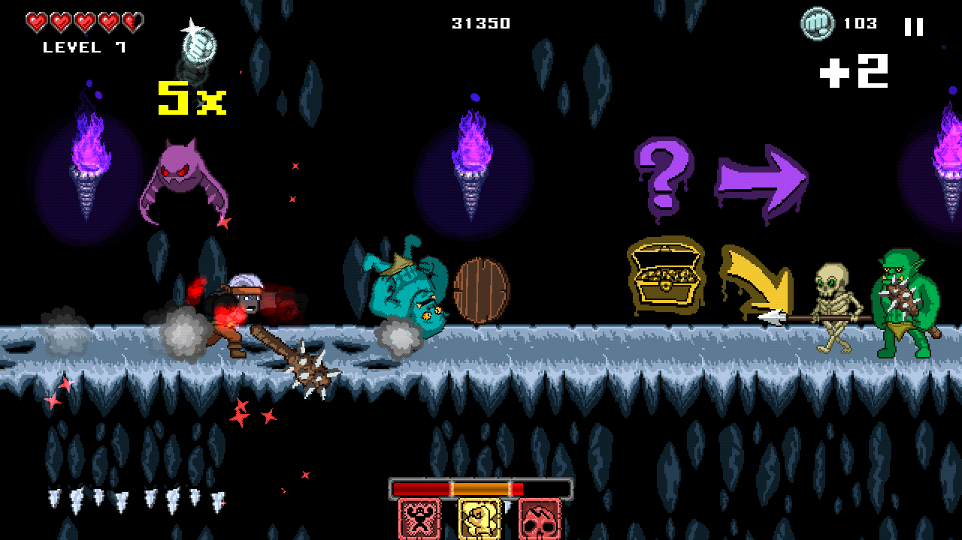
Enemy types:
Flying
Walking
Static

Slide 18
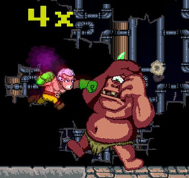
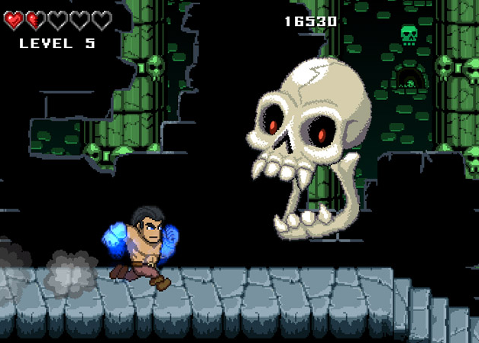
Enemy Features
Enemy Attack types:
Melee
Ranged
Drop Attack
Enemy Bosses:

Slide 19
Enemy Movement
Enemies will move in two ways:
Linearly – (right to left)
In a pattern – ( spiral, wave, zig zag )

Slide 20
Physics SubSyStem
RigidBODIES and Colliders
Ground DETECTION
INGAME ANTIGRAVITY
RAGDOLLS

Slide 21
PHYSICS SUB SYSTEM
EXPLOSIONS
Forces AND TORQUES to support special powerups.
Trigger zones

Slide 22
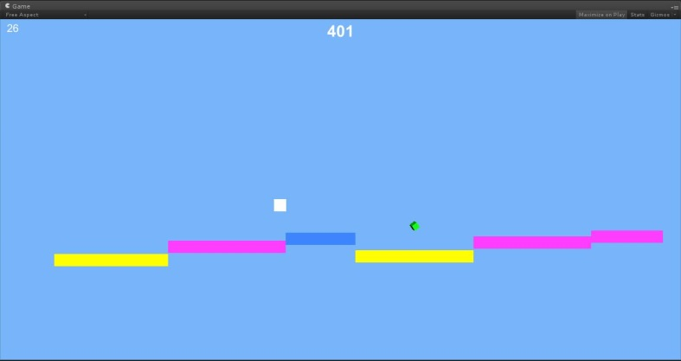
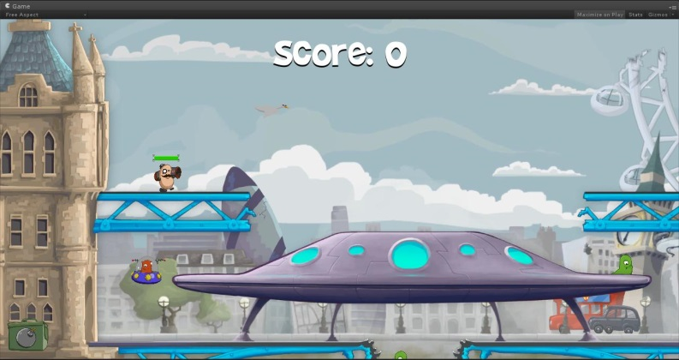
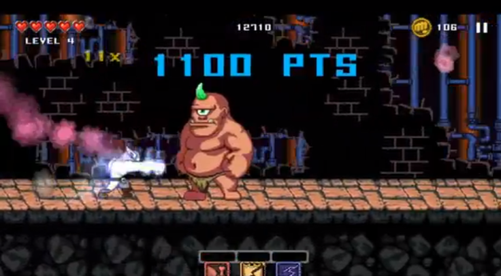
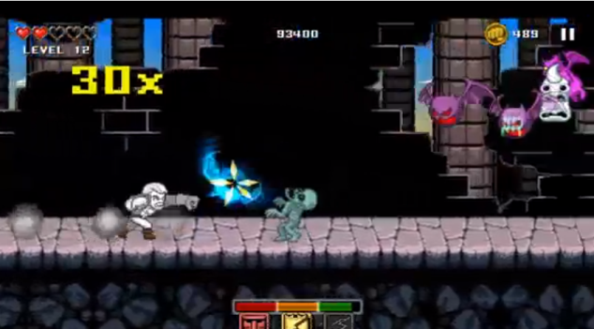
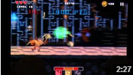
Procedural level generation
ENDLESS LEVEL GENERATION:
FEASIBLE LEVELS
INTERESTING LEVELS
APPROPIATE SKILL LEVEL
Multi layer level generation with parallax dynamic backgrounds
SMOOTH TRANSITION BETWEEN DIFFERENT SCENARY

Slide 23
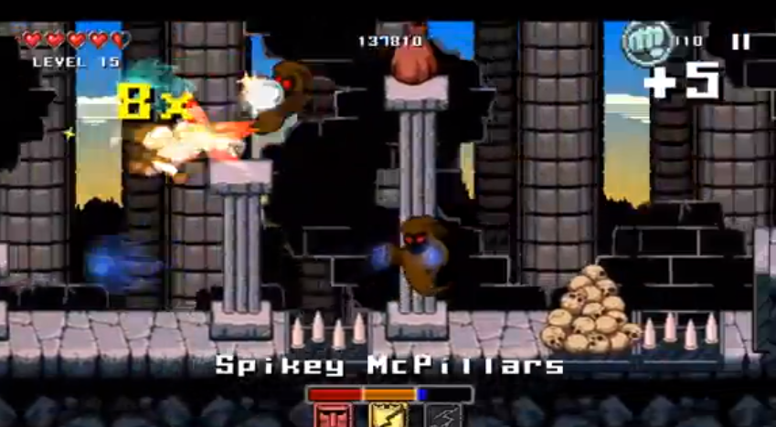
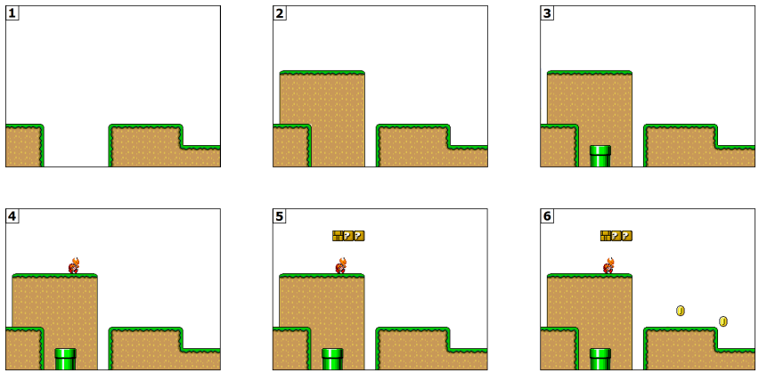
Procedural level generation
Dynamic level traps:
Gaps with traps
Vertical Traps
Traps falling from sky
Multi-phase level generator:
Ground generator
Floor, hills, and stairs generator
Pipes, and pillars generator
Enemies generator
Powerups generator
Coins generator

Slide 24
TEAM MEMBERS
SABARISH CHANDRAMOULI ( HERO – COMBAT SYSTEM)
MODDY BAGS ( Artificial intelligence )
ASHISH GYANENDRA ( PHYSICS)
KASHYAP RAJPAL ( UI – GAME FLOW)
ALBERTO GUERRA ( PROCEDURAL LEVEL GENERATION)

